Slide 1
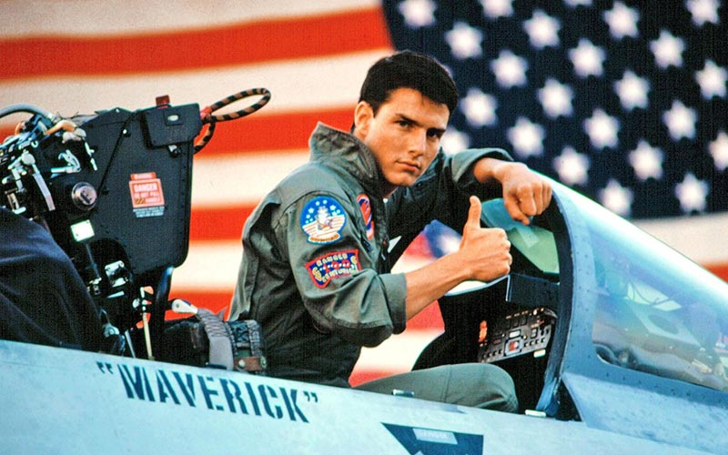
Navy Air Movies and Aerial Combat

Slide 2
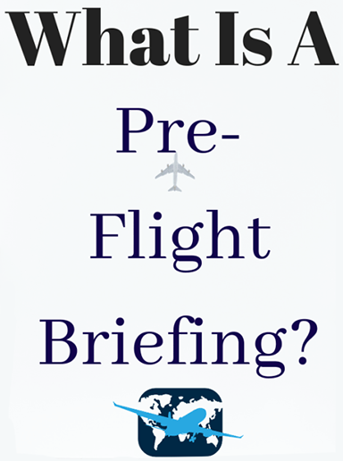
Coming Attractions
Originally a movie intro
At a retirement community
For Top Gun
Still movie-themed
But with more substance
And a look at the future
Notes:
TG and TG Maverick are blockbusters. Cruise’s star power has revitalized the movie
Industry after covid shut down theaters. This presentation will help you astonish
your friends and neighbors when you discuss the movies.

Slide 3
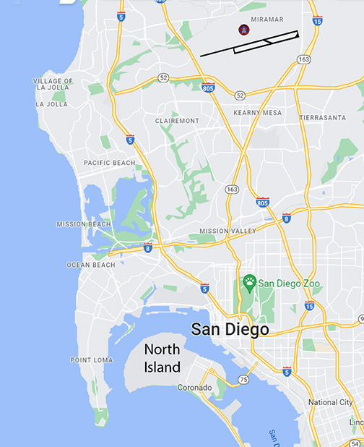
Where It All Started

Slide 4
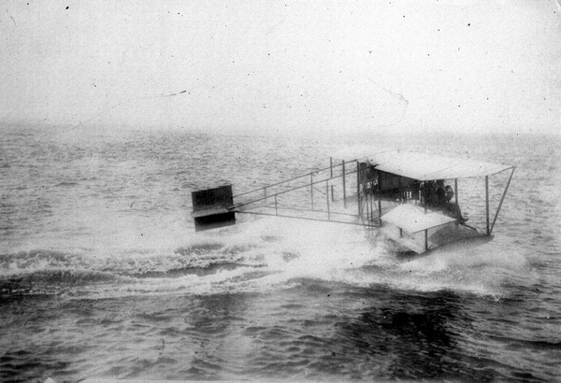
Birth of Navy Air, North Island, 1911
Curtiss A-1
Notes:
Cost $4,400
About $132,000 in today’s dollars
But only mahogany and silk
Powered by a 75hp v-8

Slide 5
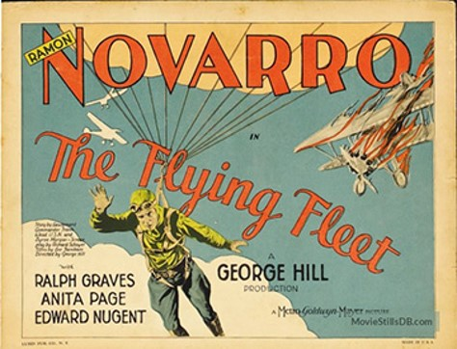
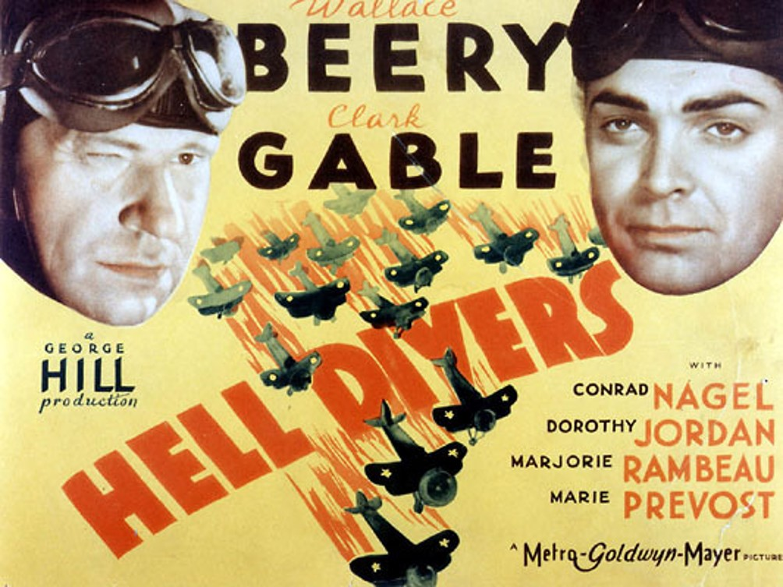
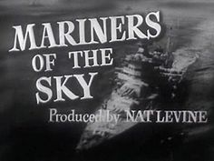
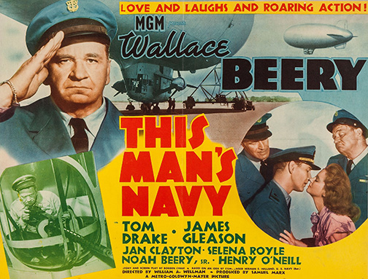
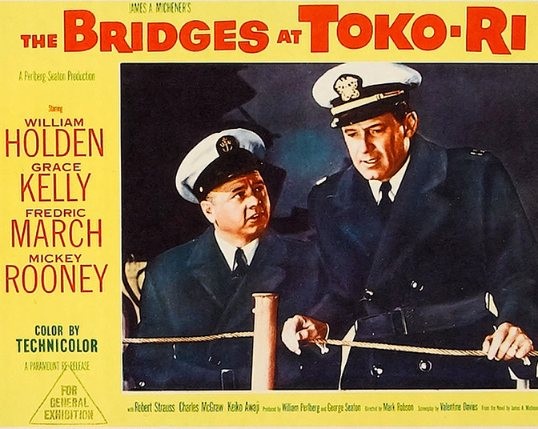
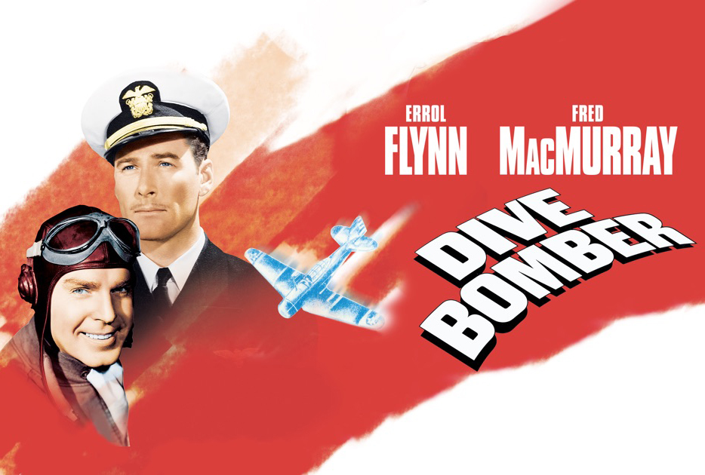
Navy Air Goes to the Movies
1929
1931
1936
1941
1945
1954
Notes:
Flying Fleet was the first
Hell Divers the second, note Wallace Beery
Mariners of the Sky was the worst
Pilot returns, wife has died leaving him a newborn
Pilot tries to conceal newborn
Hilarity ensues
Dive Bomber notable for epic drinking bouts between Flynn and Navy pilots
This Man’s Navy included for Wallace Beery
Many WWII propaganda movies skipped
Bridges at Toko-Ri featured Mickey Rooney as Wallace Beery

Slide 6
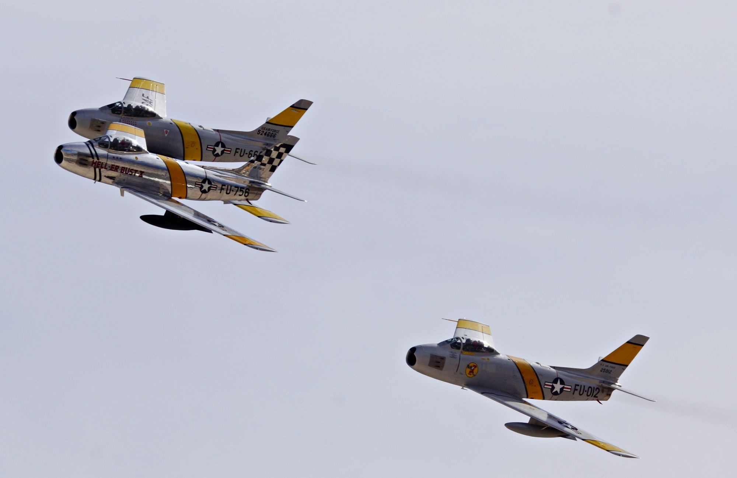
After the 40’s Came the 50’s
Notes:
Original claim: 10:1 victory/loss ratio
Better gun sight
Moving tail plane
Aggressive training at Nellis
Later revision: closer to 2:1

Slide 7
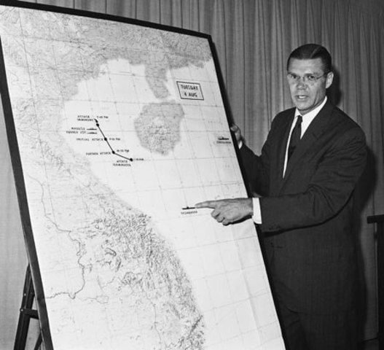
And the 60’s: Gulf of Tonkin
1964
Notes:
Apparently Gulf of Tonkin resolution was in preparation before the incident
LBJ said that for all he knew, the Navy was shooting at whales

Slide 8
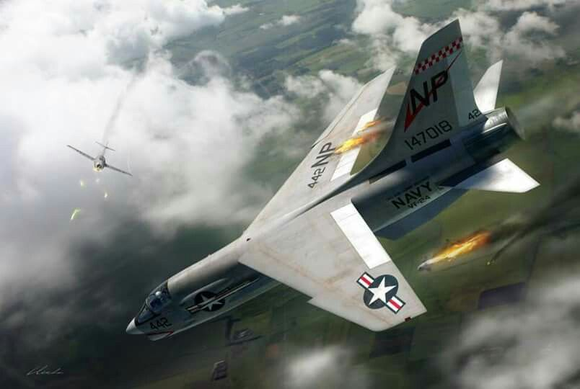
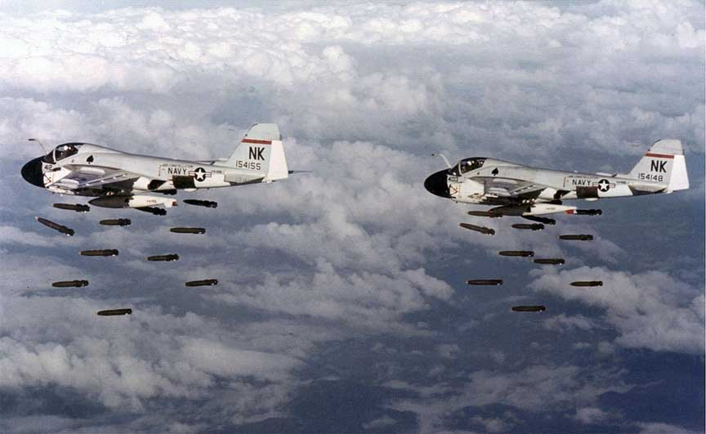
Rolling Thunder
MiG-15 and F-8
A-6’s
Notes:
2 March 1965 until 2 November 1968
Limited because of fear of wider conflict with Chinese/Soviets
Closely managed from DC/Pentagon
Gradualism
Airfields off limits
Interservice rivalry

Slide 9
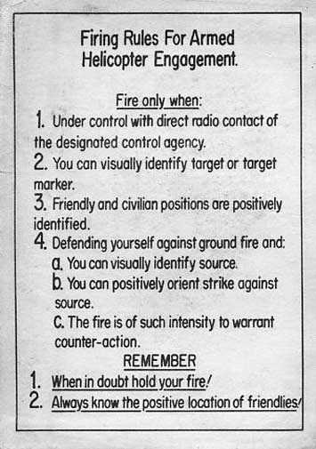
Rules of Engagement
Notes:
For fixed wing, key #1 was only the designated target
NVA airfields could not be engaged
NVA a/c on the ground could not be engaged
Key #2 was visual ID, lest you shoot down a friendly

Slide 10
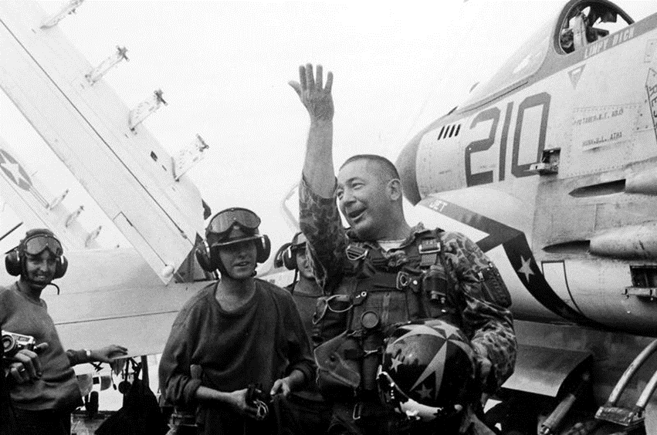
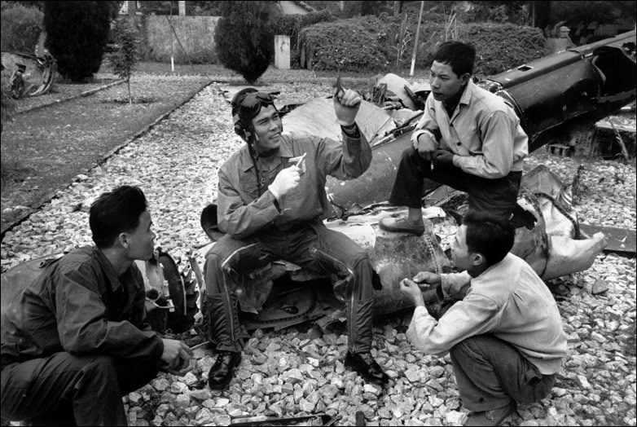
Victory/Loss Ratio
Notes:
Dick Bellinger after shooting down MiG-21, 1966
NVA personnel unknown
Before Top Gun: 3.7 to 1
After Top Gun: 13:1
But kills are always exaggerated, losses always minimized (mis-attributed)

Slide 11
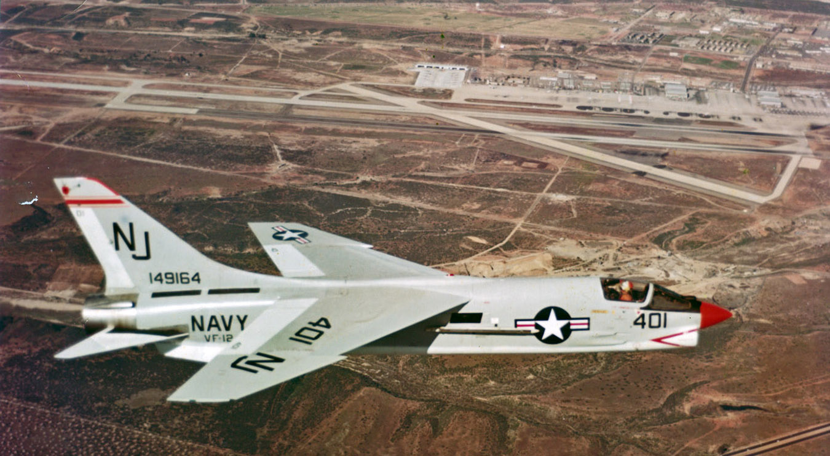
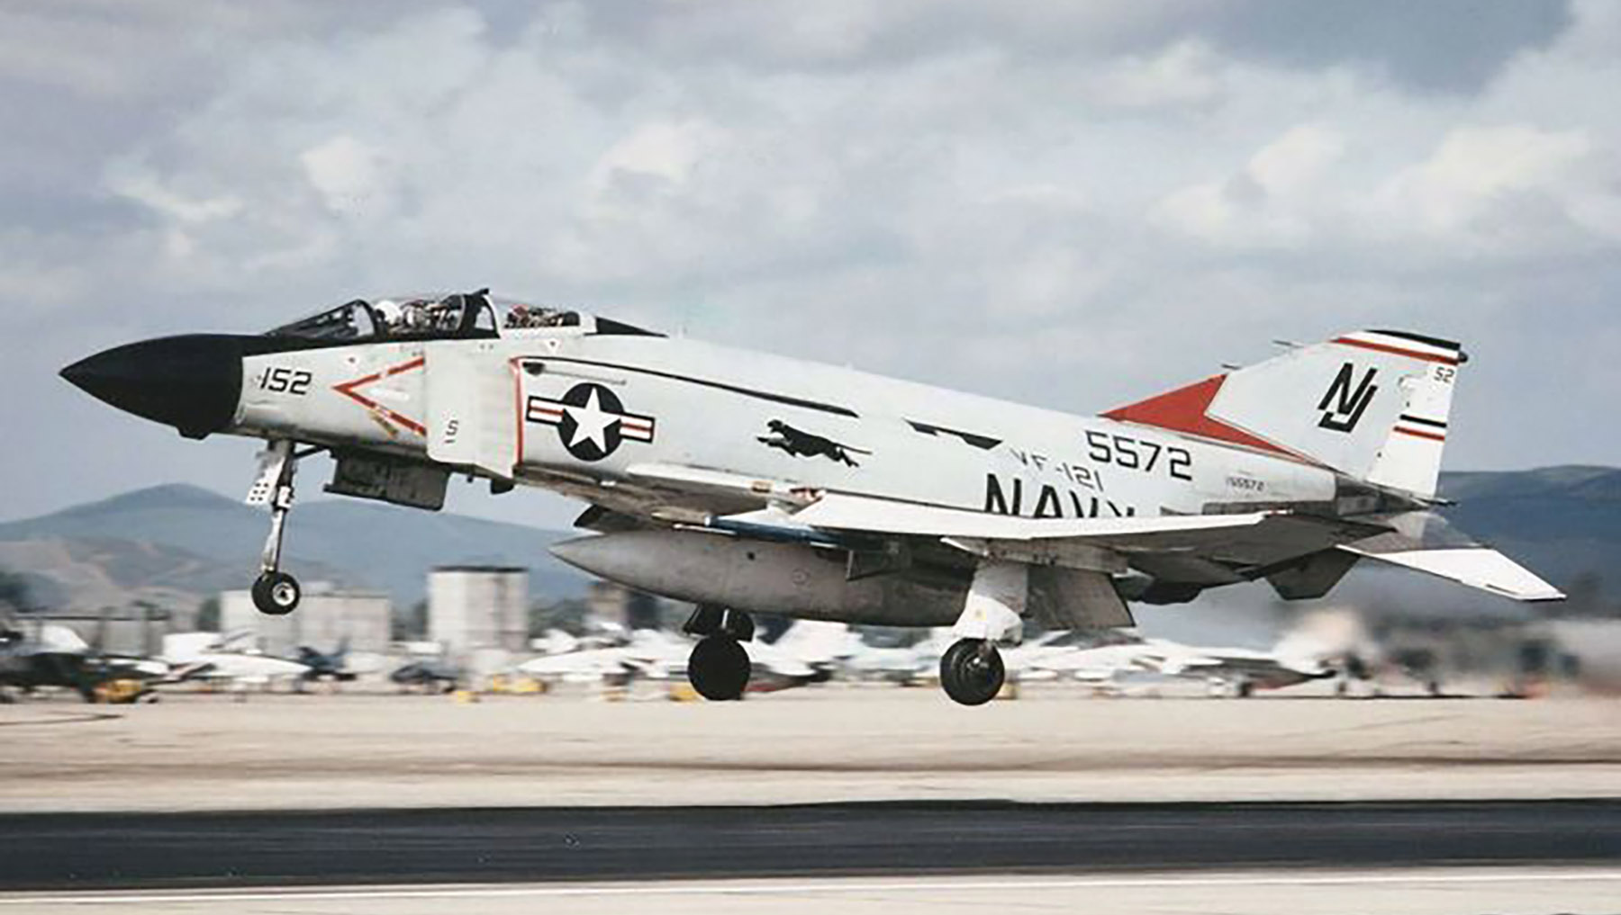
Meanwhile, Back in the States
VF-124
F-8 Crusader
VF-121
F-4 Phantom
Notes:
F-8 first flew in 1955; last time (U.S.) in 1970.
F-8 first fewl in 1958; last time (U.S.) in 1996.
Never flew 149164, but flew 149145 several times.

Slide 12
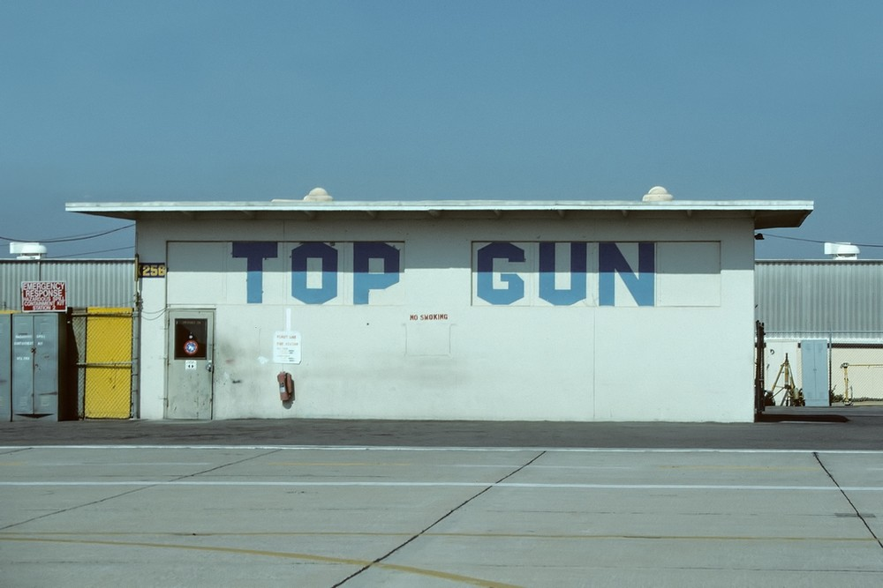
Navy Fighter Weapons School, 1969
Notes:
Could not find picture of original home, an Airstream trailer

Slide 13
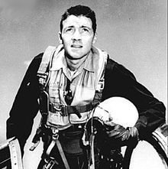

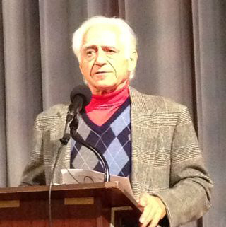
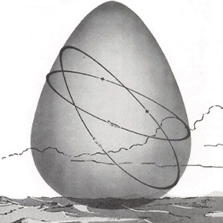
Learning from the USAF
John Boyd, 1927--1997
Thomas Christie, 1934--
Pierre Sprey, 1937--2021
Energy/Maneuverability
Notes:
This team used mainframe computers to compare U.S. vs. Soviet aircraft
The team went on to design the F-16 and the A-10

Slide 14
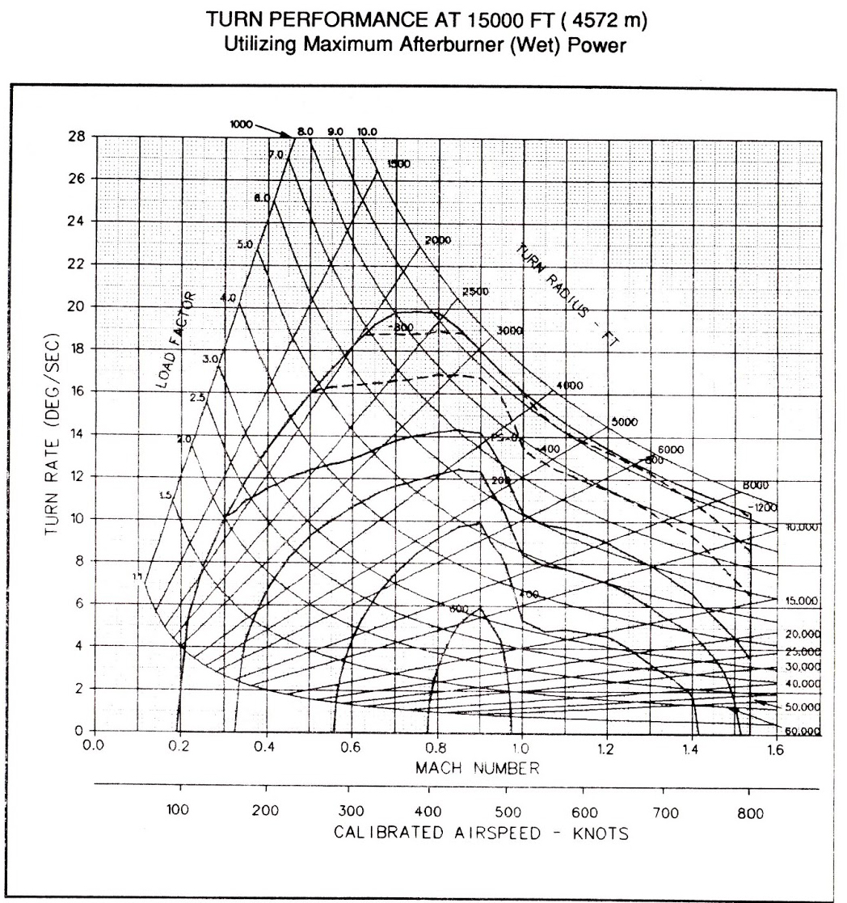
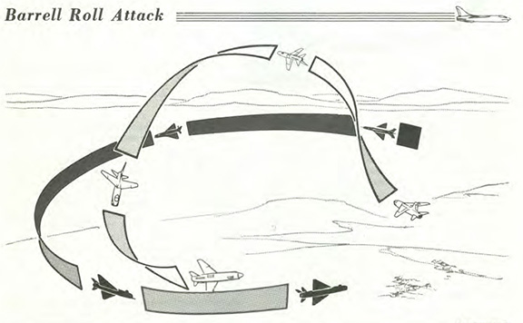
Course Content
Notes:
An important component is maneuvering against dissimilar a/c

Slide 15
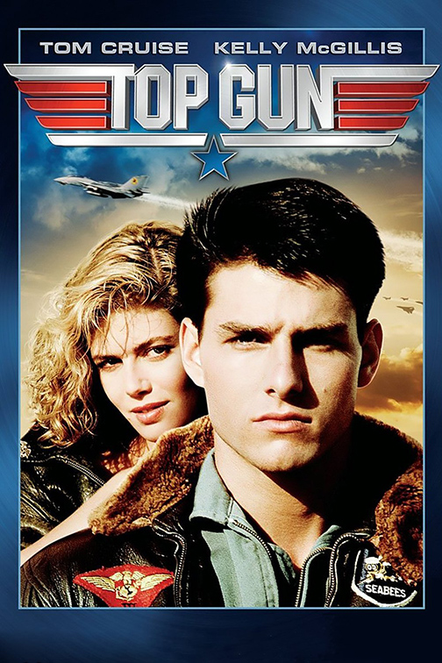
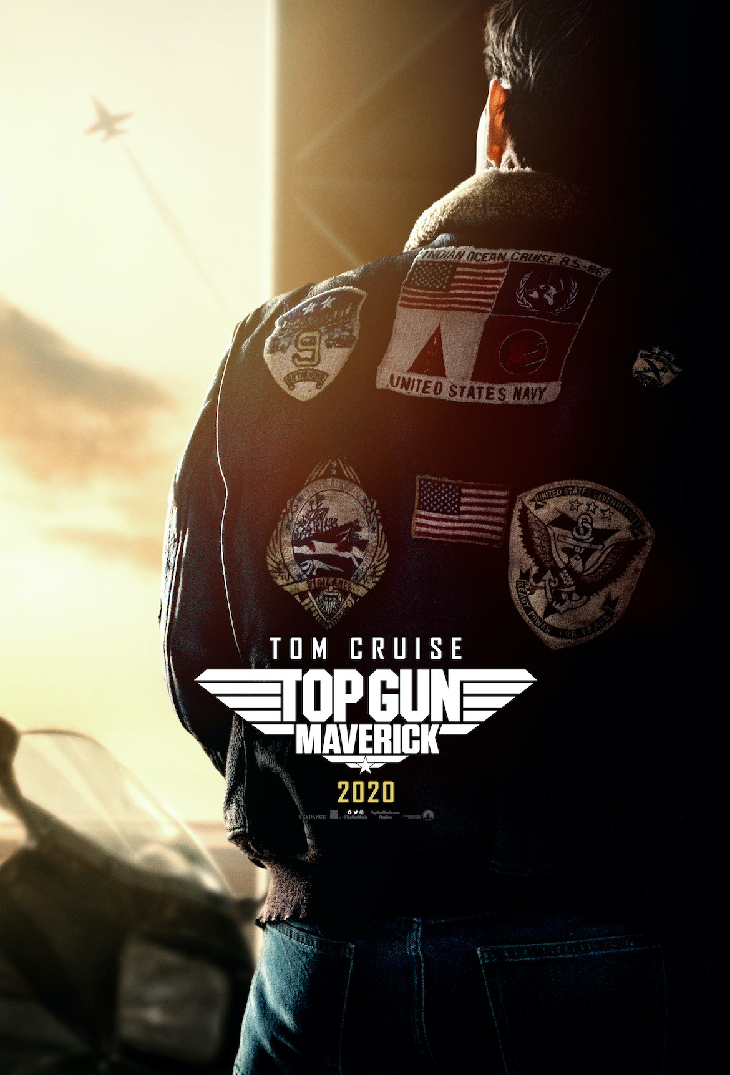
Back to the Movies
1986
2020
Notes:
Patch weirdness

Slide 16
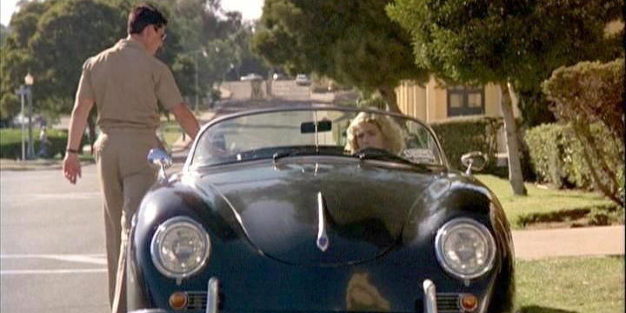
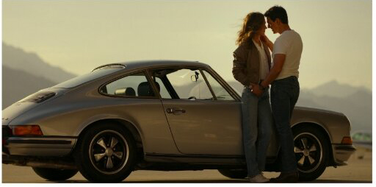
Same: Porsches

Slide 17
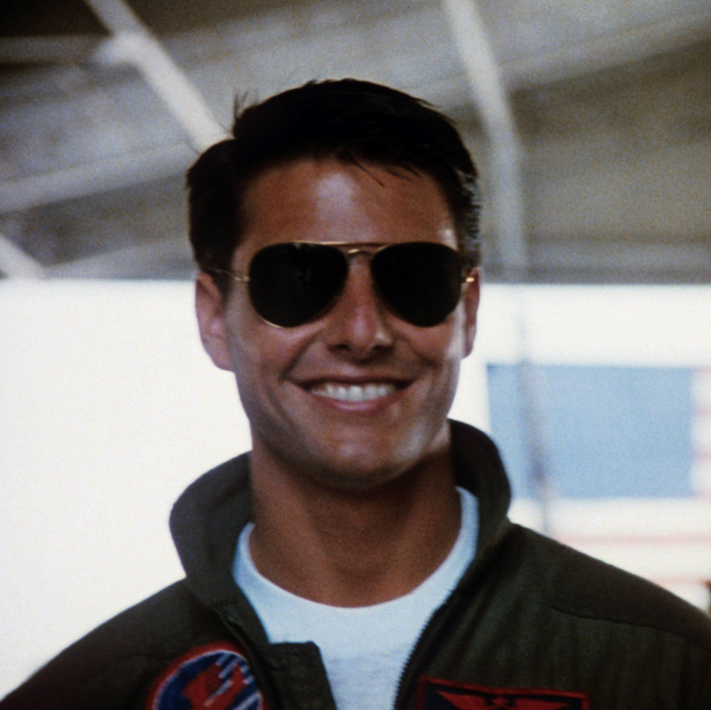
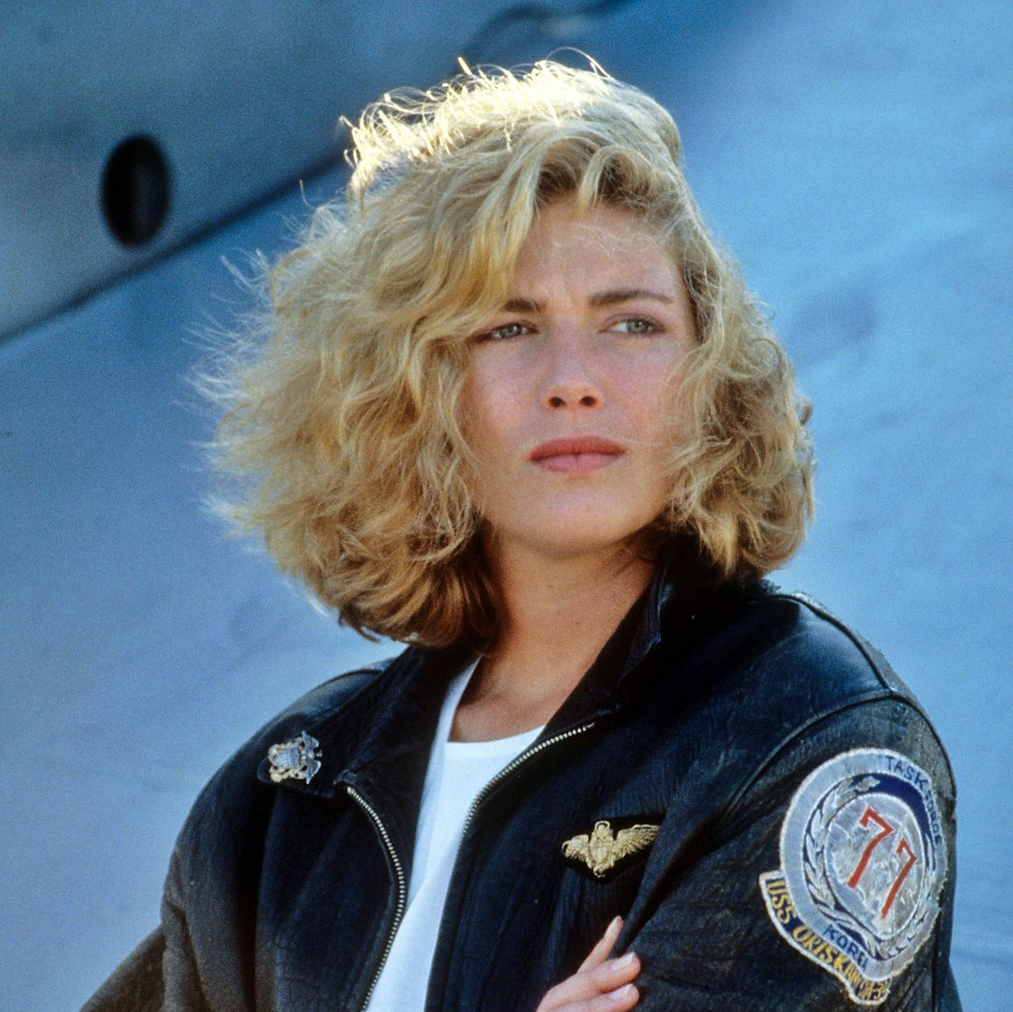
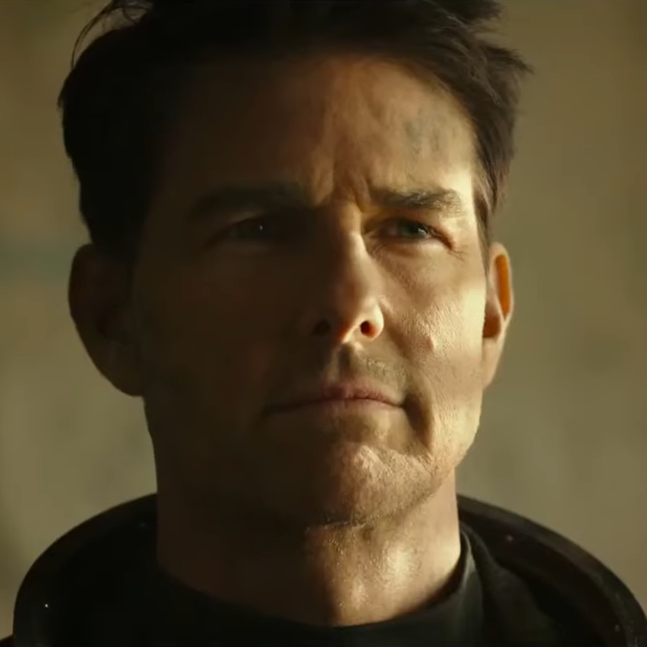

Different: Ages
24
28
59
49

Slide 18
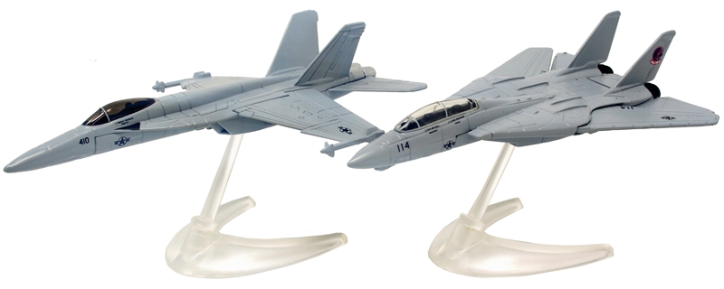
Different: Aircraft
F18
F14

Slide 19


Really Different: Beach Volleyball
Notes:
Search YouTube for “Quentin Tarantino Top Gun Homosexuality”
Best is https://www.youtube.com/watch?v=OxzwfZ2Wa94&t=3s
“… a story about a man’s struggle with his own homosexuality.”

Slide 20
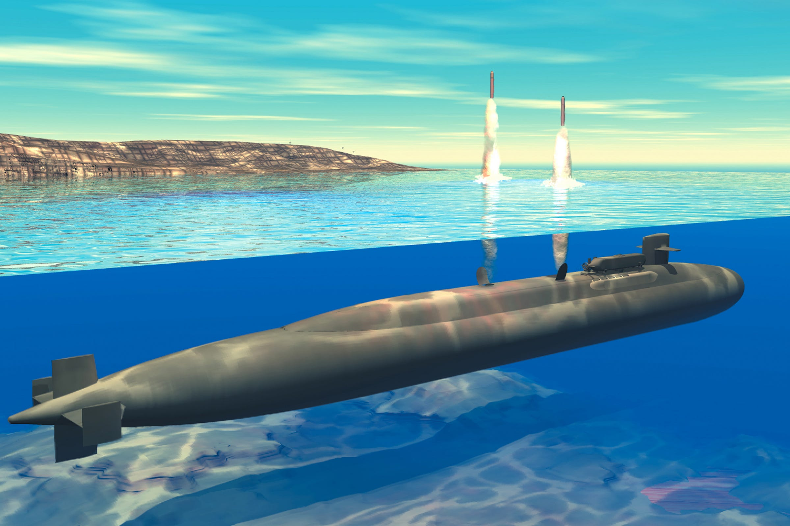
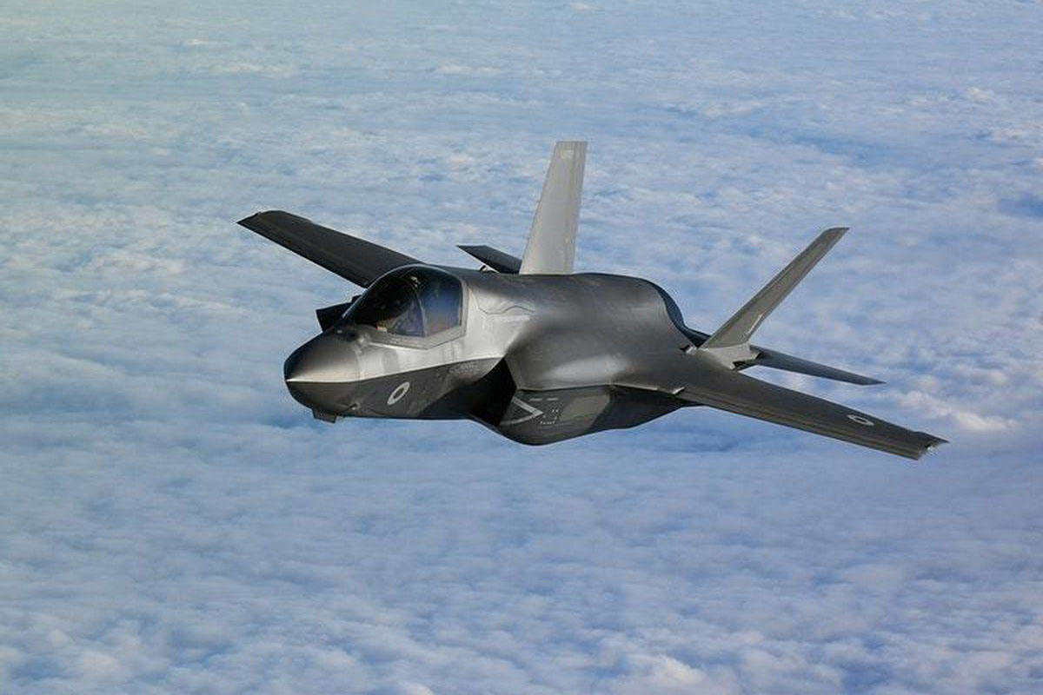
Afterthought: Why F18’s?
Because it’s entertainment!

Slide 21
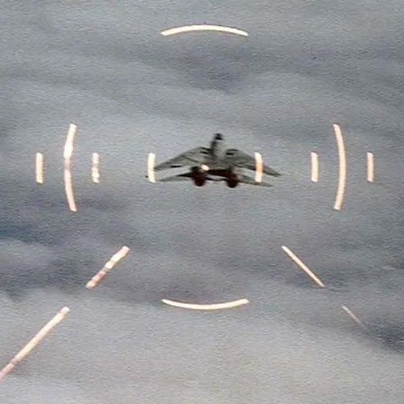
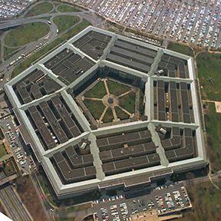
What’s going on here?
War In the Movies
Drama
Training
Tactics
Strategy
Politics
Logistics
Procurement
War in Real Life
Procurement
Logistics
Politics
Strategy
Tactics
}{
Intelligence
Training
Attitude
Luck
Corruption
Notes:
One of Clausewitz’s trinities: Power, Politics, Chance.

Slide 22
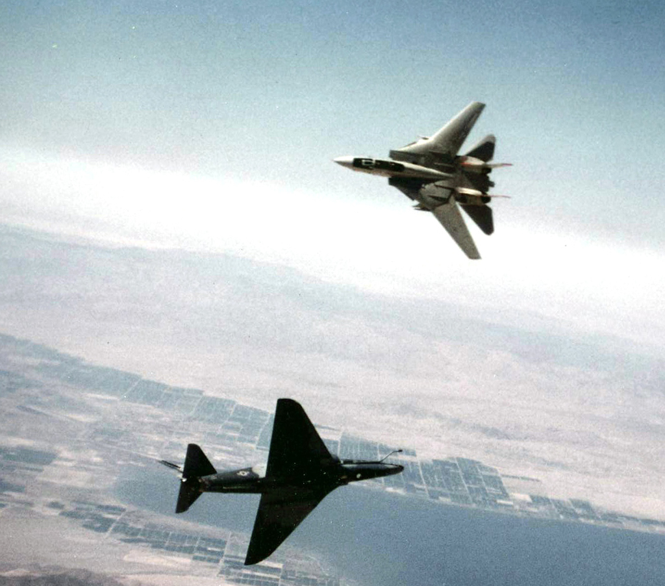
Tactics
Maneuver After Engagement

Slide 23

Strategy
Maneuver Before Engagement

Slide 24
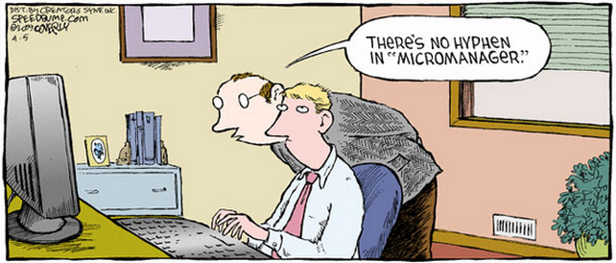
Politics
Limits on Engagement
Movies
Seven Days in May, 1964
Dr. Strangelove, 1964
Wag the Dog, 1997
In the Loop, 2009
Notes:
ROE
Safe haven
Micromanagement
PR metrics
In the Loop: The US President and UK Prime Minister
fancy a war. But not everyone agrees that war is a good
thing. The US General Miller doesn't think so and
neither does the British Secretary of State for
International Development, Simon Foster.

Slide 25
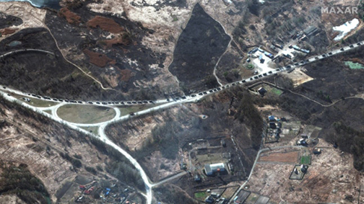
Logistics
Enables Engagement
Movies
The Red Ball Express, 1952
Zulu Dawn, 1979
Danger Close, 2019
40-Mile Russian Convoy Near Kyiv, 2022
Notes:
Planning
Admin
Billeting
Supply
Transportation

Slide 26
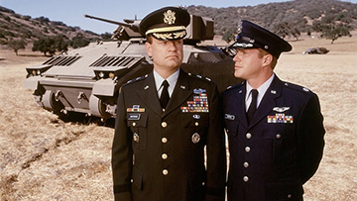
Procurement
Tools for Engagement
Movies
The Pentagon Wars, 1998
Notes:
“You go to war with the army you have, not the army you might want or wish to have at a later time.”
― Donald Rumsfeld
Russia
Iranian drones
NK munitions
Obsolete tanks
No chips
Ukraine
Javelins
ManPADs
HiMobArtyRocketSys

Slide 27





Other Factors
Intelligence, Training, Attitude, Luck, Corruption
The Imitation Game, 2014
Full Metal Jacket, 1987
The Red Baron, 2008
The Lucky One, 2012
Three Kings, 1999
Notes:
The Lucky One: A Marine travels to Louisiana after serving three tours in Iraq and searches for the unknown woman he believes was his good luck charm during the war.
Three Kings: four American soldiers on a gold heist that takes place during the 1991 uprisings in Iraq against Saddam Hussein following the end of the Gulf War.
Kelly’s Heroes: a motley crew of American GIs who go AWOL in order to rob a French bank, located behind German lines, of its stored Nazi gold bars.

Slide 28
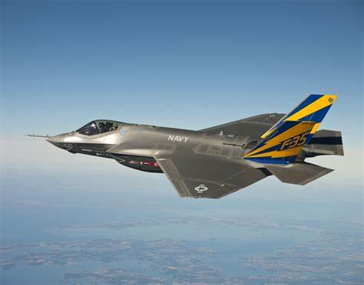
Future of Air Combat: F-35
Lockheed Martin Lightning II
First flew in 2000
Multirole/multiservice (JSF)
Stealth
Beyond visual range
Not a dogfighter
Expensive
Movie: Stealth, 2005
Notes:
Flew in 2000
Multirole/multiservice
Last manned a/c?
Helmet display
Stealth
BVR
Not a dogfighter

Slide 29
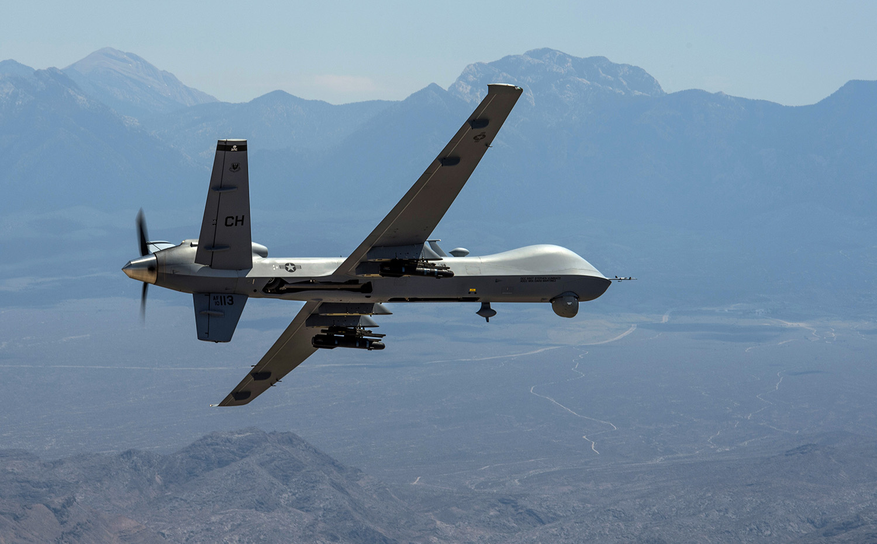
Future of Air Combat: Drones
General Atomics MQ-9
No weak link
Weight saving
More G’s
No pilot losses
Loss of prestige
Control/autonomous
Ethics
Movie: Good Kill, 2014

Slide 30
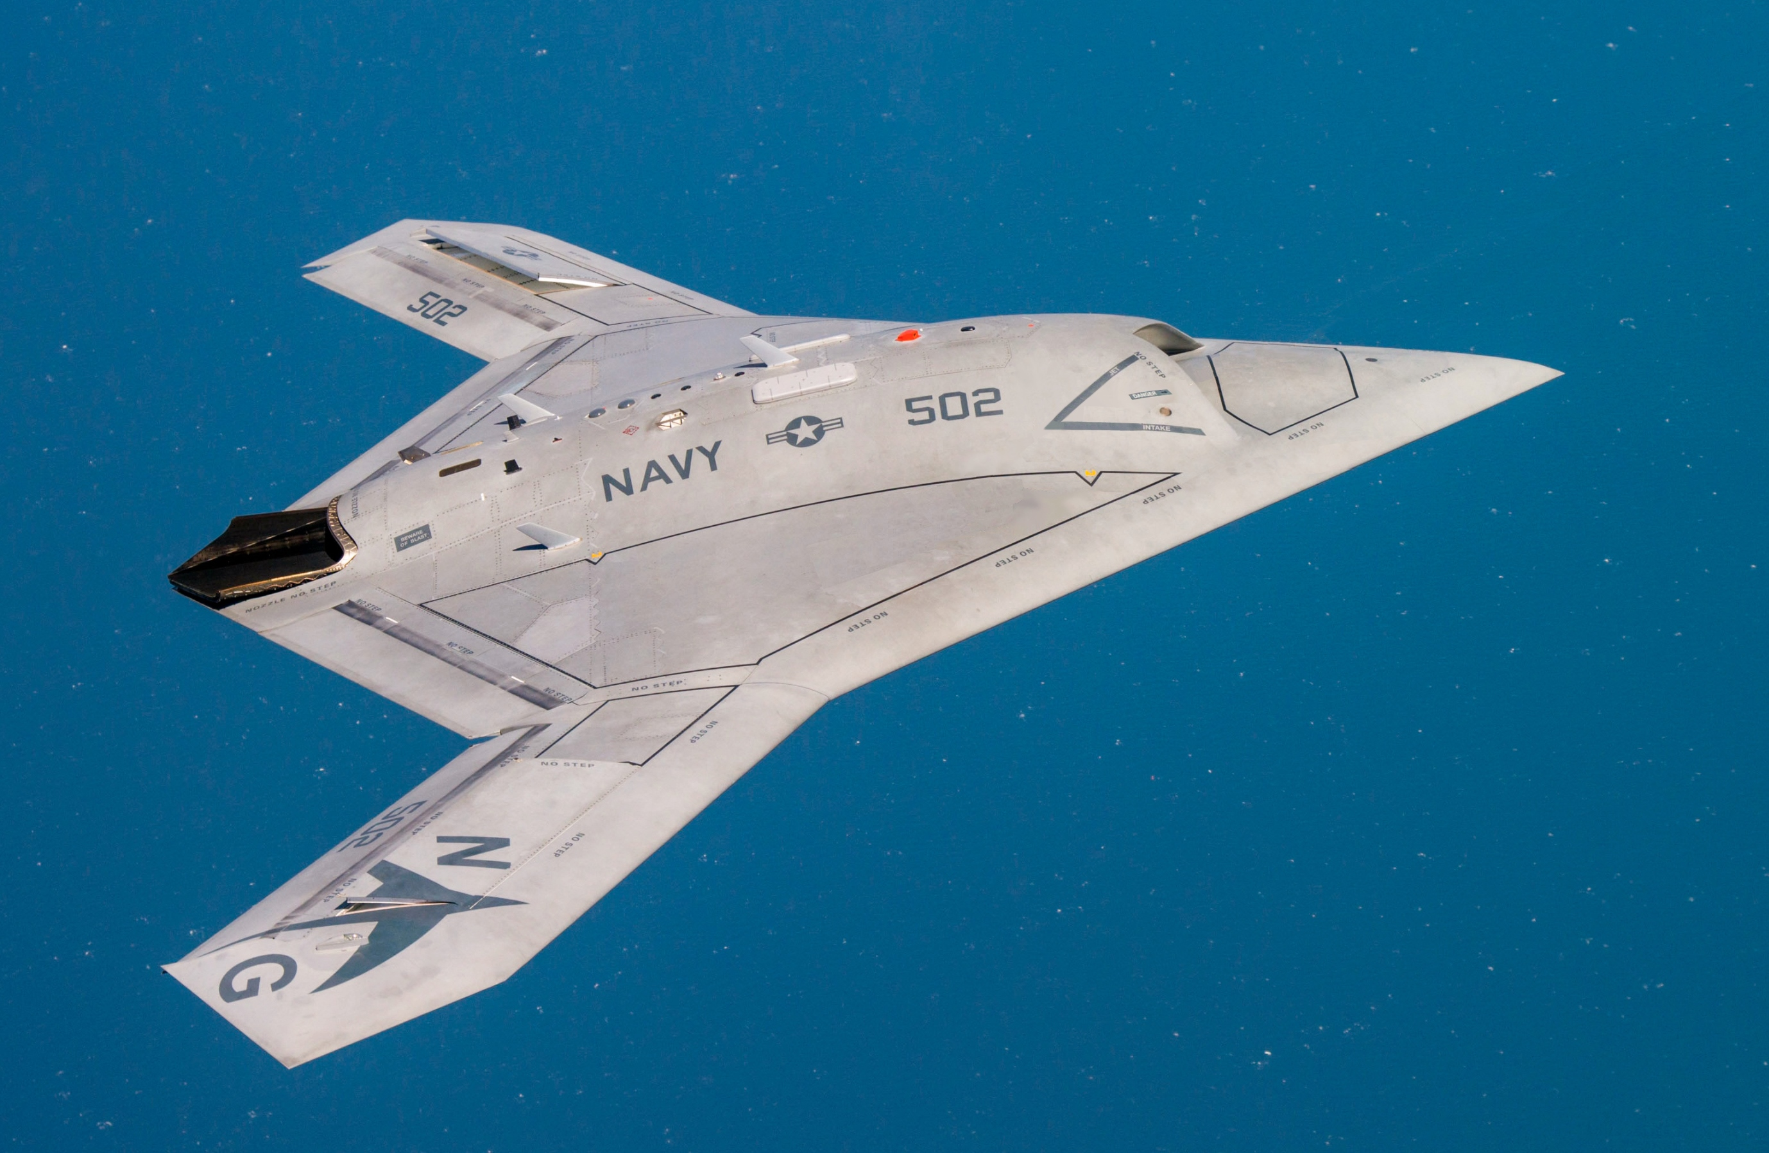
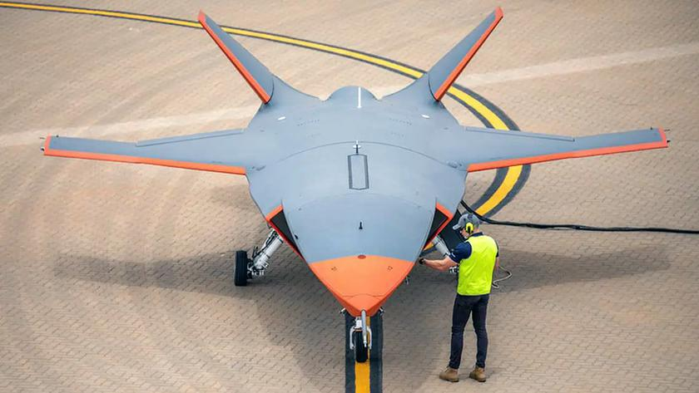
Future of Air Combat: Combat Drones
Northrup Grumman X-47B, 2011
Boeing Ghost Bat, 2021

Slide 31
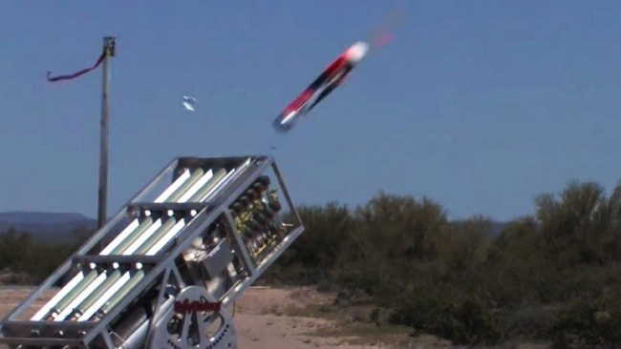
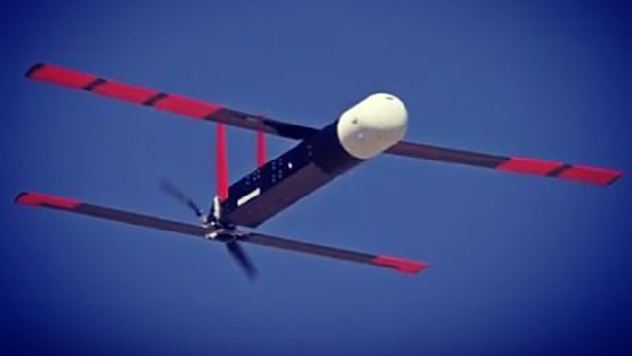
Future of Air Combat: Swarms
Movie: Angel Has Fallen, 2019
Notes:
Angel Has Fallen: A swarm of armed drones attack the President

Slide 32

Chock ‘Em and Chain ‘Em

